Slide 1
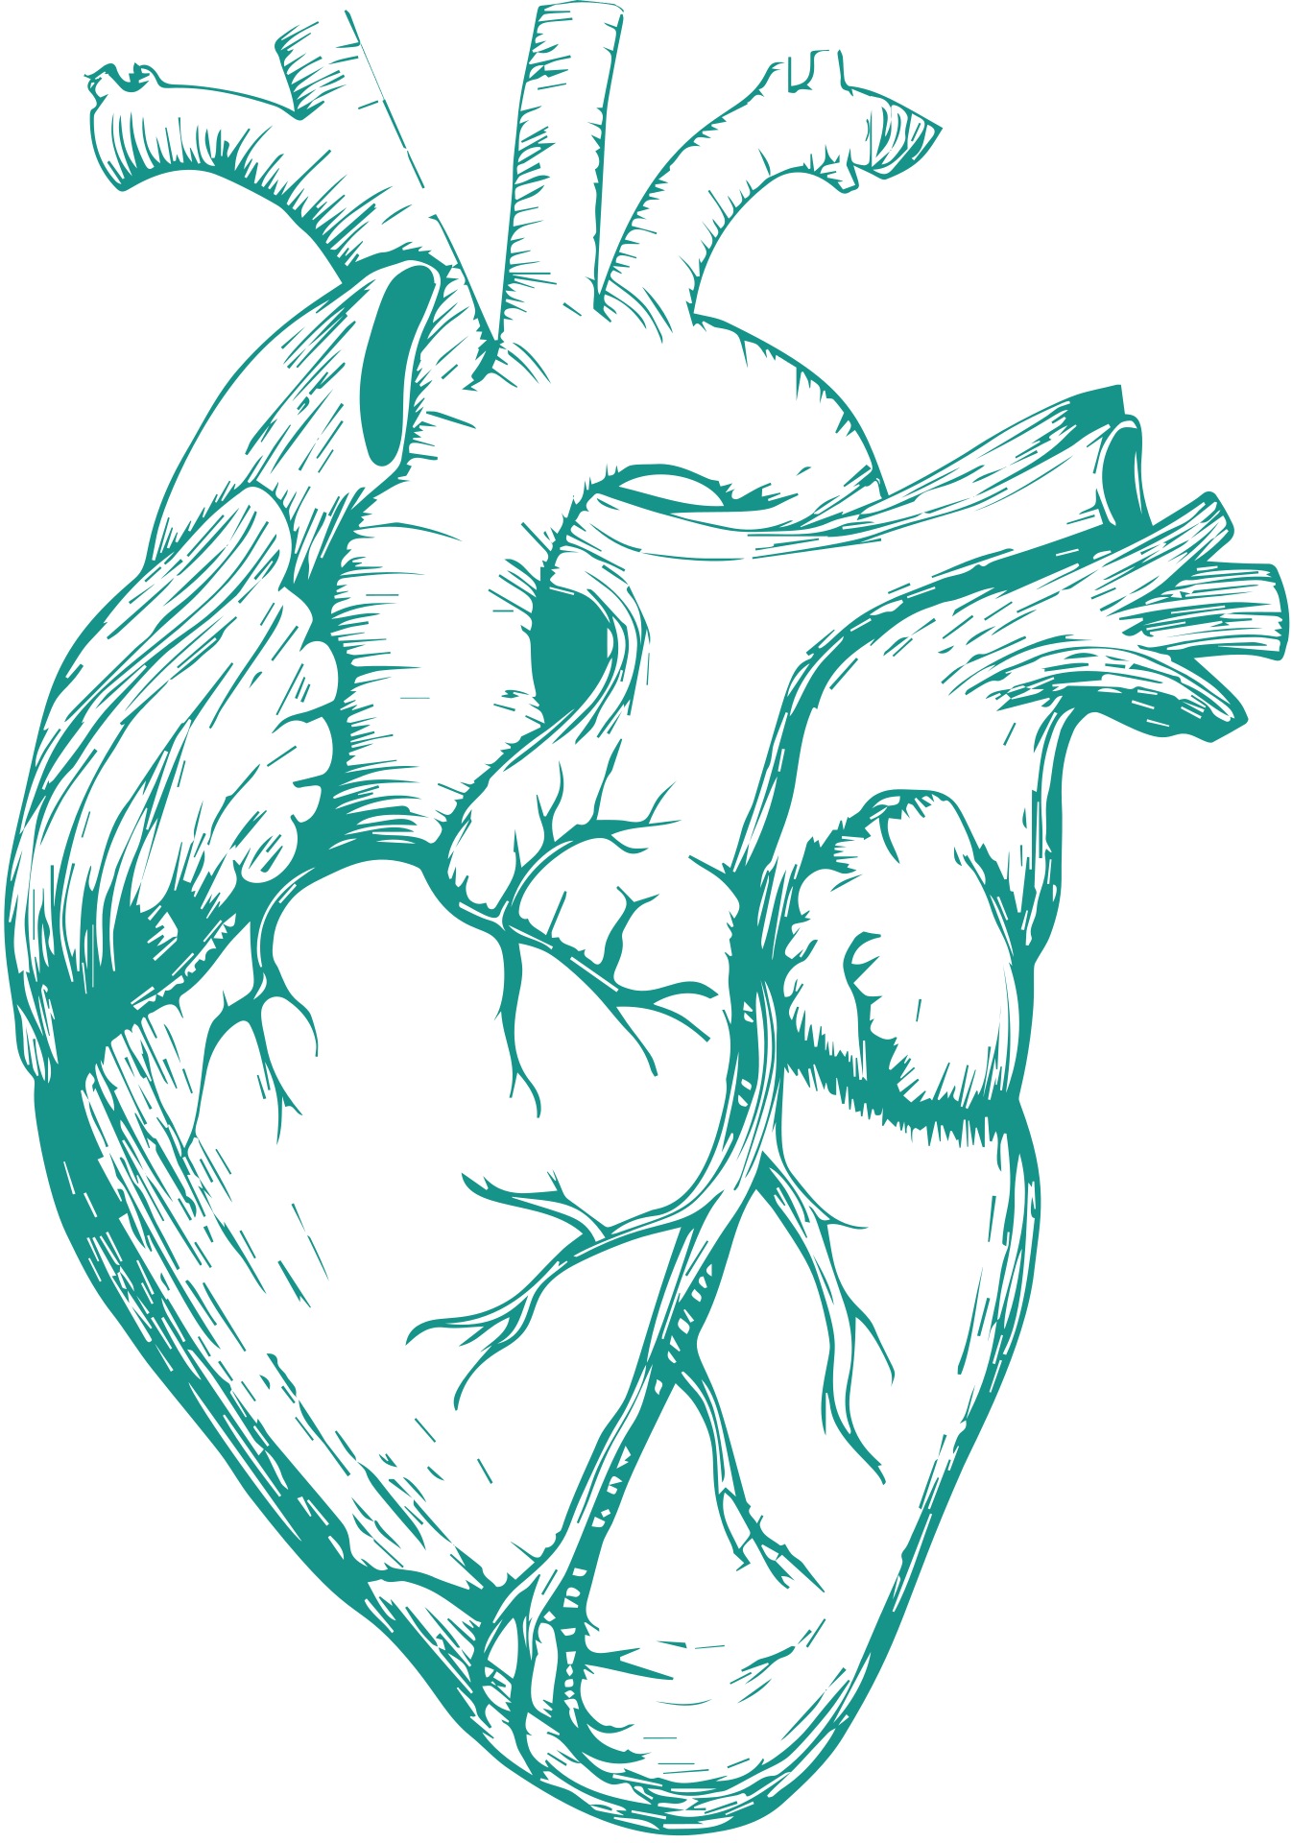


Northeastern University
CARDIO VASCULAR
RISK ANALYSIS
IE6600-COMPUTISATION AND VISUALISATION
FINAL PROJECT- GROUP 4

Slide 2







OUR TEAM
A Bunch of aspiring Data professionals
Shubham Gaur
Anjali Haryani
Jaamie Maarsh
Kalyan Kumar
Payal Chavan

Slide 3

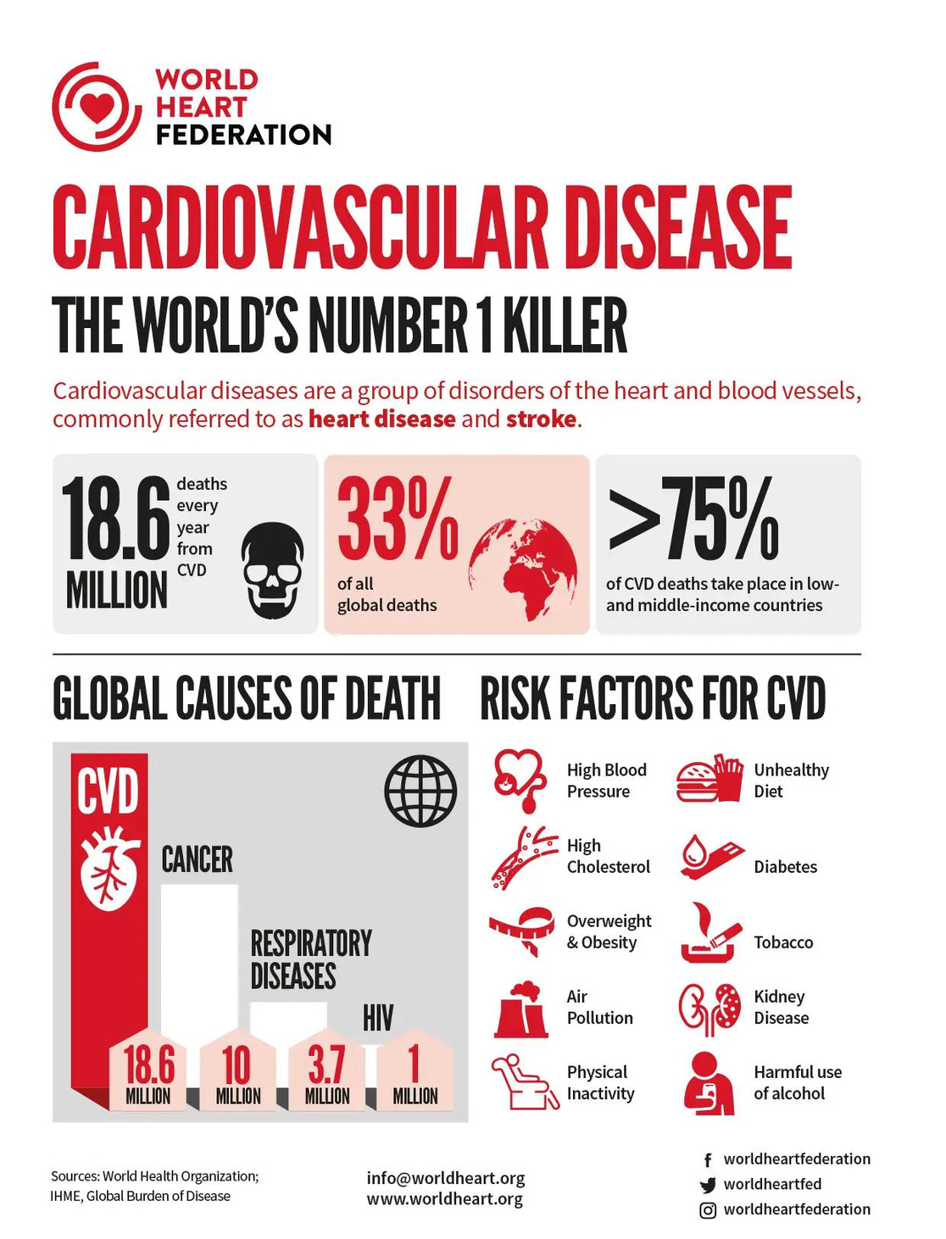

WHY CVD?
One person dies every 33 seconds in the United States from cardiovascular disease.
About 695,000 people in the United States died from heart disease in 2021—that’s 1 in every 5 deaths
Stats Courtesy: https://world-heart-federation.org/resource/cardiovascular-disease-infographic/

Slide 4

QUESTIONS TO BE ANSWERED...
Determining the prevalence of CVD across catagories.
Find out the major factors causing heart diseases?

Slide 5
Methodology
01
01
Phase 01
02
Data reading and Understanding
02
Phase 02
03
Data Cleaning/Pre-processing
03
Phase 03
Approach and Methods
04
04
Phase 04
Data Visualisation & Analysis
05
05
Phase 05
Answering the question, Improvements & Learnings

Slide 6





DATA HANDLING
Data Source
Data Preprocessing
Nature of Data
Database Source -Kaggle
Other resources - Centres for Disease control and prevention
Null values
Duplicate values
Feature Engineering
Outlier values
Binary values
Uncertain data values
Unclear bins

Slide 7

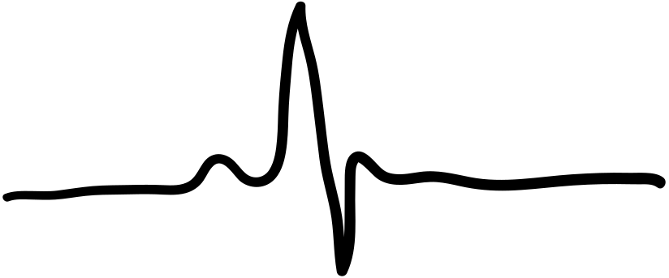
Identify most significant risk factors
Analyze patterns
Visualize prevalence of CVD
VISUALIZATION
GOALS
Communicate Results

Slide 8
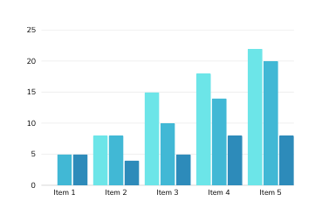
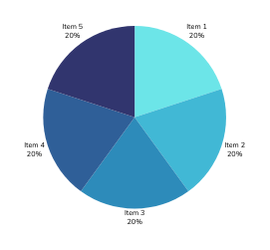

VISUALIZATION CHOICES
“Developing Charts, Analyzing Visualizations, and Driving Insights"
Bar Graphs
Line Graphs
Pie Charts
Compare frequency of categorical data.
Count Plots.
To analyze trends of different columns.
Percentage of the population.

Slide 9
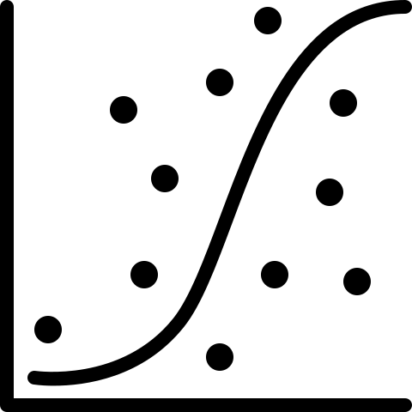
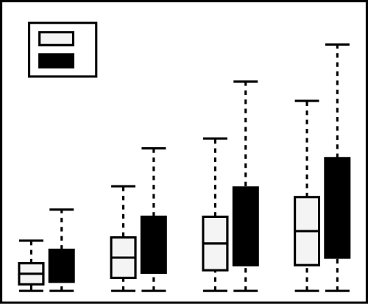
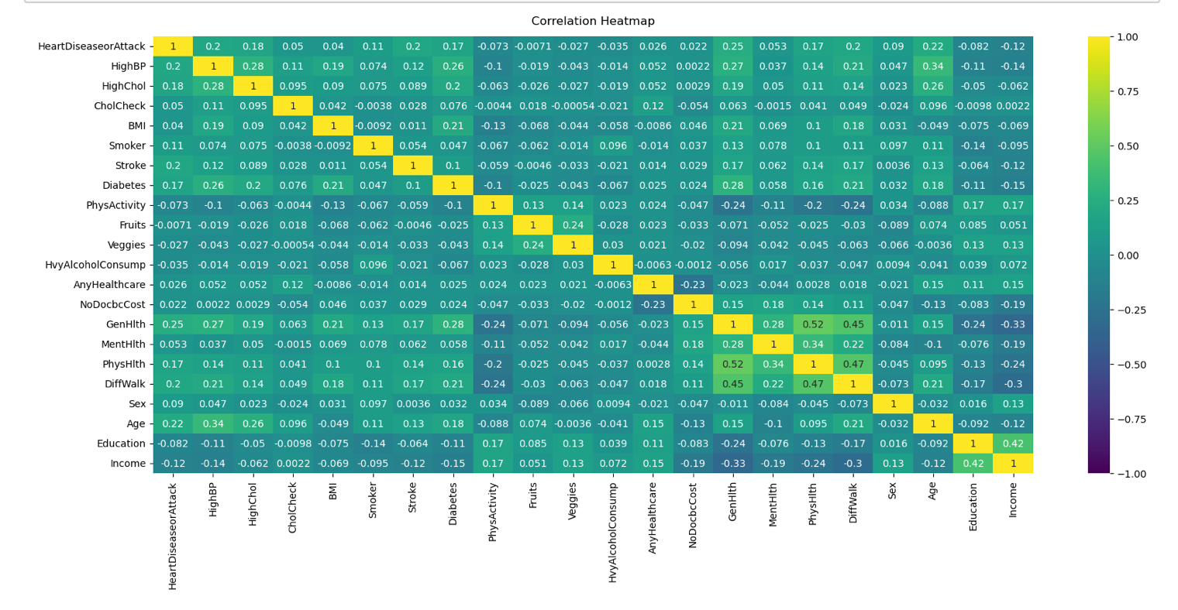
VISUALIZATION CHOICES
“More Charts, More Visualizations, and More Insights"
Scatter Plots
Box Plots
Heatmaps
To identify correlational relationships and patterns.
To display the distribution of data, and identify outliers.
Correlation between different factors.

Slide 10




Design and Development
“Unveiling Patterns, Overcoming Challenges, and Driving Insights"
Define Objectives and Scope
Analyzing Data
Discuss Challenges Related to Data Quality and Consistency
Describe Data Preprocessing Techniques
Visuals and Insights

Slide 11
DESIGN CHALLENGES
Uncertain data values
Binary values
Continuous Data
One Hot Encoding
Education, Income etc.
Converted to Categorical Data
Gender, Smoker etc.
Feature Engineering
BMI, Age

Slide 12



DATA VISUALISATION TOOLS
Applications that enable the creation of graphical representations of data analysis, and communication of complex information
PYTHON
TABLEAU
Data Preprocessing
Custom Analytics
Flexible Data Manipulation
Easy Drag-and-Drop Interface
Beautiful Visuals
Explore Easily

Slide 13

DATA VISUALIZATION
“Key Visualizations, Interpretations & Insights”

Slide 14
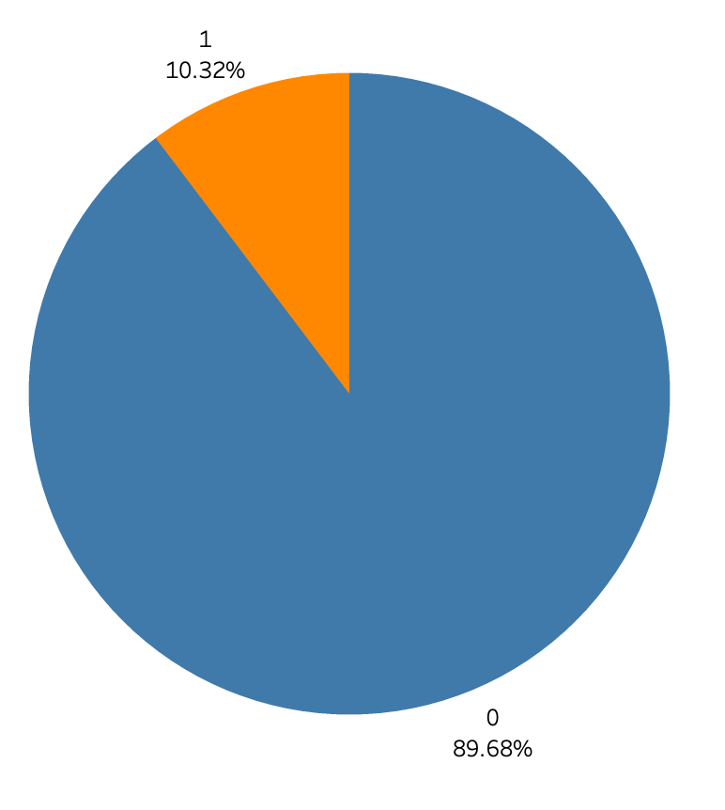
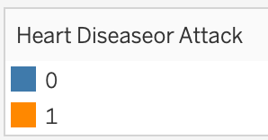

DISTRIBUTION OF HEART ATTACKS
Prevalence of Heart Disease/Heart Attack:
10.3% of the population has a history of heart disease or heart attack.

Slide 15
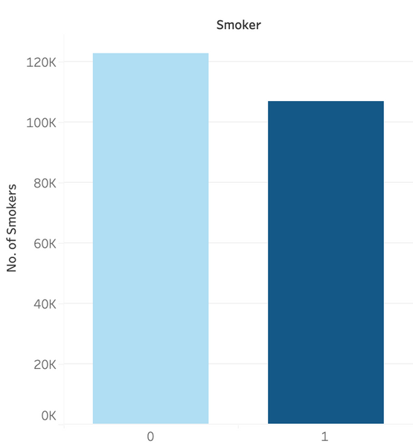
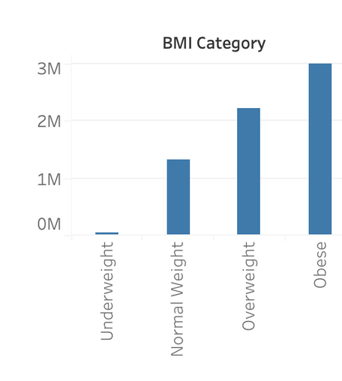
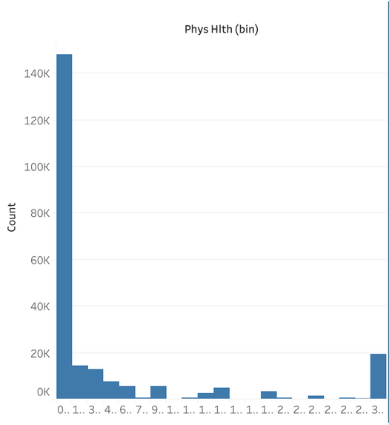
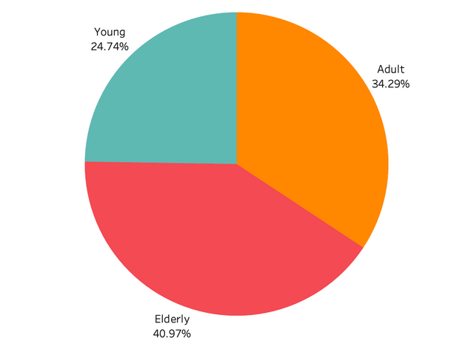
DISTRIBUTION OF DIFFERENT FACTORS
AGE DISTRIBUTION
SMOKER/NON-SMOKER
BMI DISTRIBUTION
PHYSICAL HEALTH DISTRIBUTION
Elderly age group: 41%
Young age group: 24.7%
Higher count of non-smokers.
Emphasizes the prevalence
of non-smoking individuals
'Obese' and 'Overweight': Approx. 9000 individuals
'Underweight': < 500 patients
'Normal Weight': Around 6000 patients
0 indicates people are not physically active.
Highlights a prevalent lack of physical activity in the population.

Slide 16
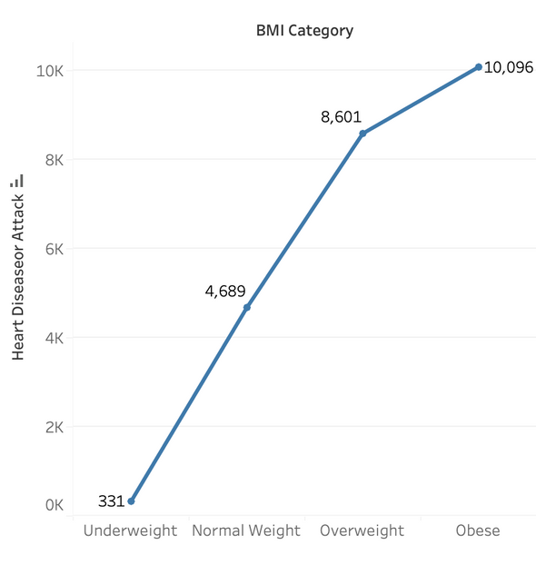
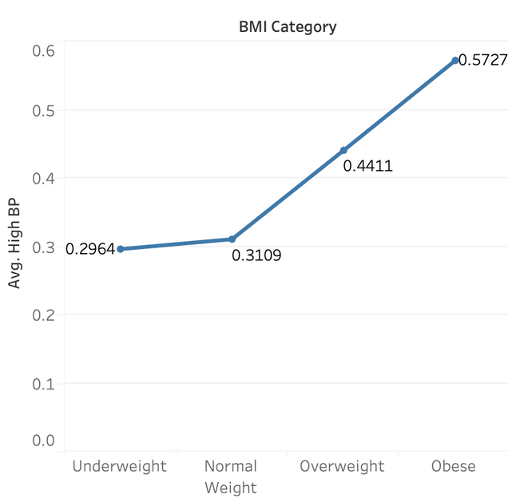
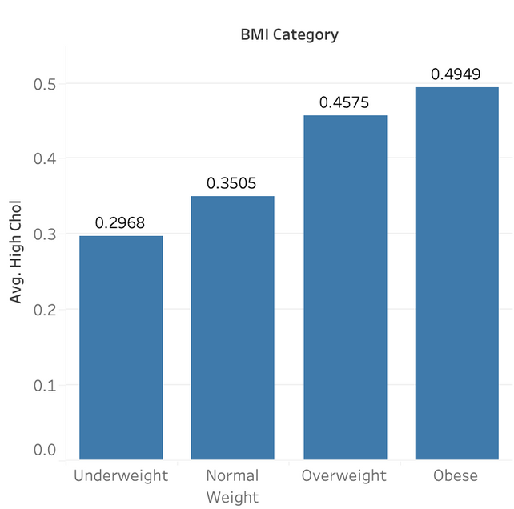
DISTRIBUTION OF HEART ATTACKS ACROSS BMI CATEGORIES
BMI CATEGORY
BMI CATEGORY WITH HIGHBP
BMI CATEGORY WITH HIGH CHOL
Correlation with increased heart disease.
Higher BMI values indicate potential risk for heart-related problems.
Clear upward trend in high blood pressure levels
Emphasizes the substantial link between weight and the risk of heart attacks.
Highlights link between weight categories.
Underscores the importance of the relationship between weight, cholesterol, and heart attack risk.

Slide 17
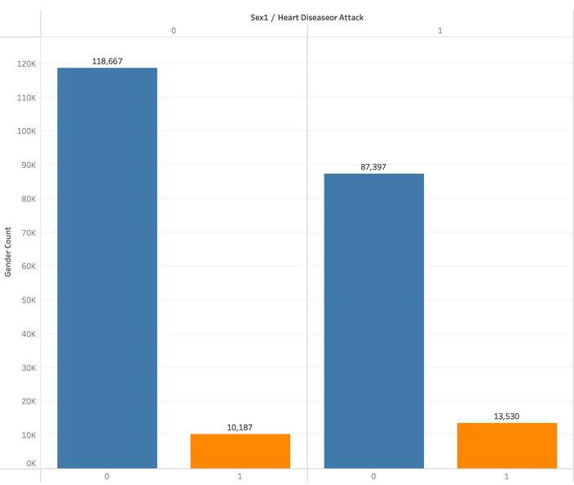
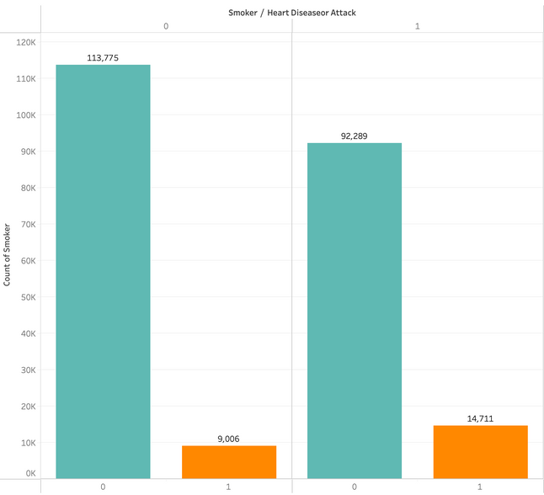
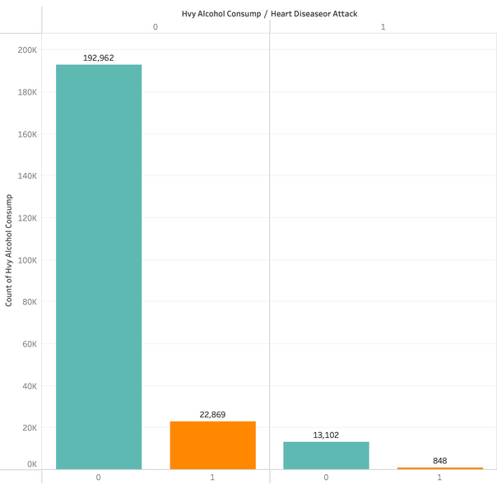
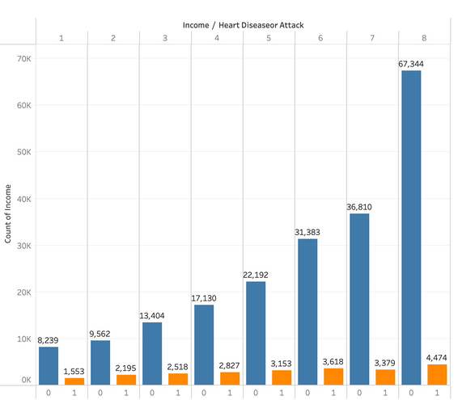
LIFESTYLE FACTORS INFLUENCING HEART ATTACKS
GENDER
/HEART ATTACK
SMOKER
/HEART ATTACK
INCOME LEVELS
/HEART ATTACK
HEAVY ALCOHOL/HEART ATTACK
Females predominate, signaling higher male susceptibility to heart attacks.
Larger female dataset emphasizes the need for balanced gender inclusion in research.
Non-smokers outnumber smokers, indicating a slightly higher risk of heart disease among smokers.
Addressing smoking-related risks is crucial, particularly in populations with higher smoking prevalence.
The dataset shows a higher likelihood of heart disease with increasing income levels.
Correlation underscores the importance of considering socioeconomic factors in health outcomes.
Heavy alcohol consumption shows an unexpected association with lower heart disease rates, warranting further investigation for nuanced discussions.

Slide 18
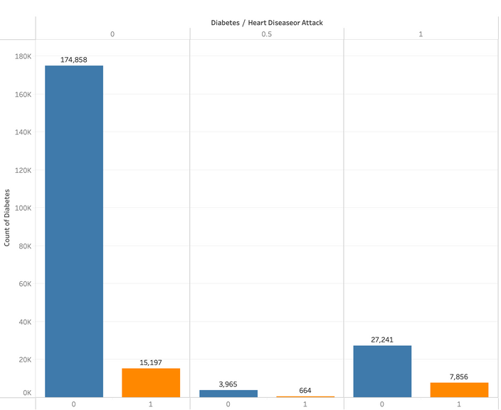
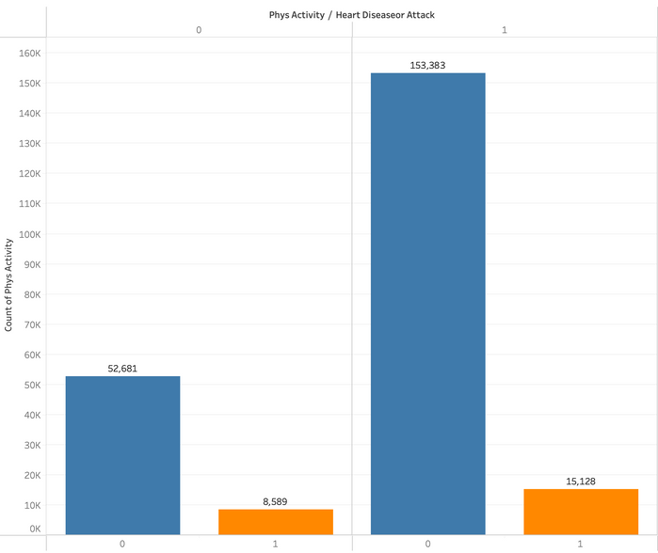
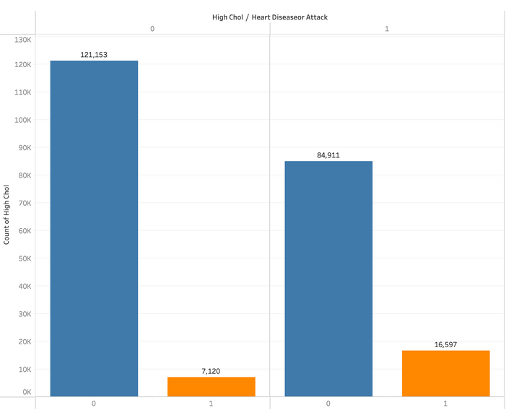
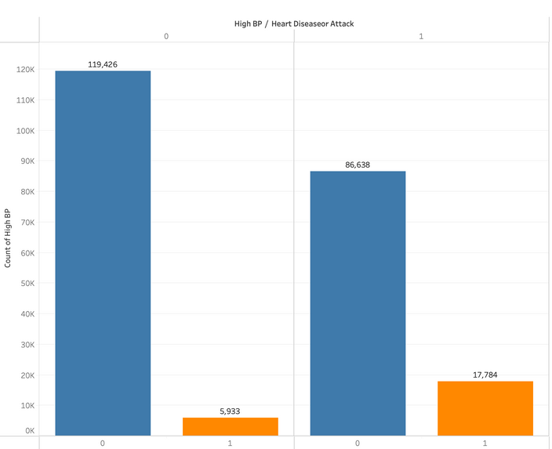

HEALTH FACTORS INFLUENCING HEART ATTACKS
HIGH CHOLESTEROL
/HEART ATTACK
HIGH BP
/HEART ATTACK
DIABETES/HEART ATTACK
PHYSICAL ACTIVITY
/HEART ATTACK
Few individuals exhibit high cholesterol levels.
Despite low prevalence, a strong association exists with increased heart disease.
High blood pressure is linked to a higher proportion with a history of heart disease.
Emphasizes high blood pressure's potential role in cardiovascular health outcomes.
The dataset reveals a scarcity of individuals with diabetes, indicating lower prevalence.
A larger proportion of those without diabetes have a history of heart disease.
Regular physical activity slightly increases heart disease susceptibility, highlighting a nuanced relationship.
Understanding specific activities and durations is crucial for personalized heart health recommendations.

Slide 19
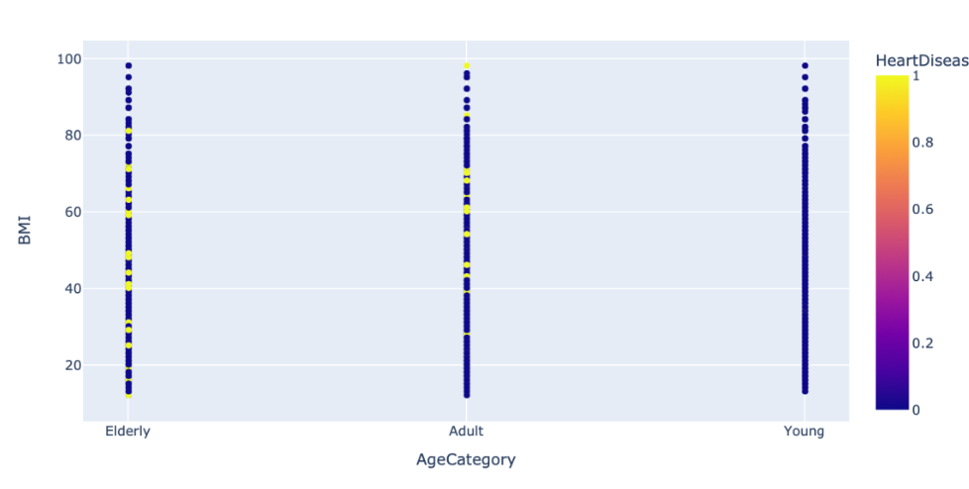
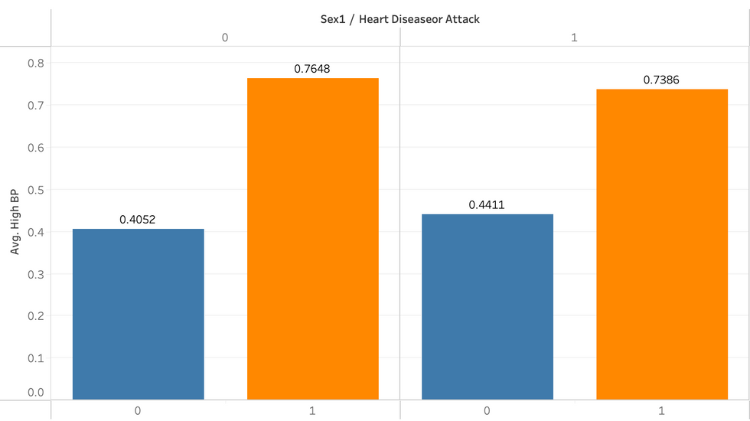
CORRELATION BETWEEN FACTORS INFLUENCING HEART ATTACKS
AGE & BMI
/HEART ATTACK
GENDER & HIGHBP
/HEART ATTACK
Scatterplot indicates higher heart disease risk in elderly.
'Adults' also show risks, influenced by activity and lifestyle.
High BMI and age strongly link to heart disease.
High blood pressure elevates cardiovascular risk.
Women have extra risk, showing gender differences.
Recognizing this is crucial for tailored prevention and care

Slide 20
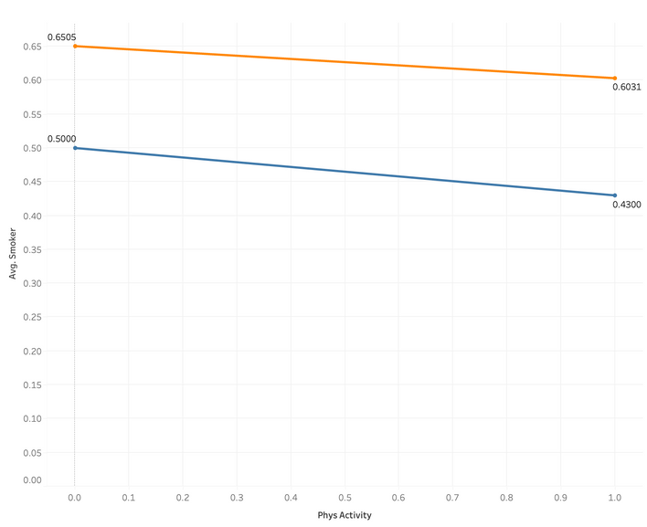
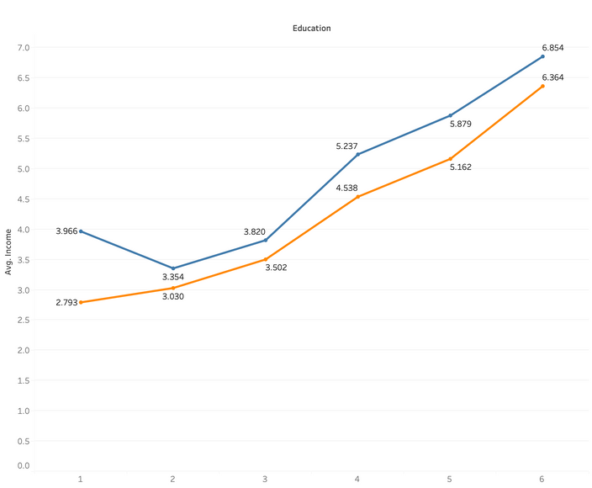
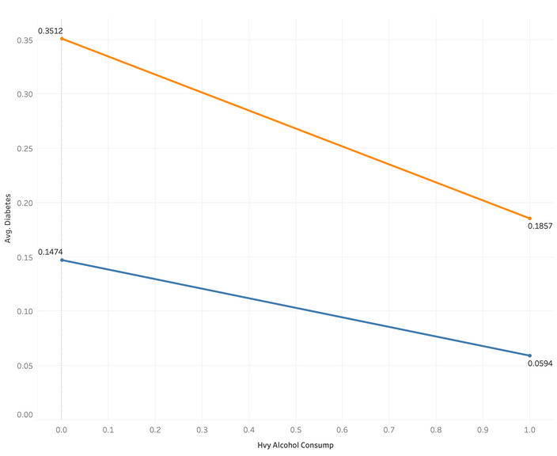
CORRELATION BETWEEN FACTORS INFLUENCING HEART ATTACKS
PHYSICAL ACTIVITY
/AVG SMOKER
EDUCATION
/AVG INCOME
ALCOHOL CONSUMPTION
/AVG DIABETES
Smoking and exercise are inversely related. This means that people who smoke are less likely to exercise.
This relationship highlights the complex interplay of lifestyle factors that can impact cardiovascular health.
Higher education and income are positively correlated, suggesting a complex interplay between socioeconomic factors and health outcomes.
The link between education, income, and stress emphasizes the importance of considering these factors in promoting cardiovascular health.
The line plot indicates less alcohol consumption linked to more diabetes.
Highlights a complex interaction affecting cardiovascular outcomes.

Slide 21
CORRELATION MATRIX
Age, BMI, High BP, High Chol, Physical health emerges as pivotal determinant in direct proportion to heart disease.
Physical Activity, Income, Education, Heavy Alcohol Consumption are negatively correlated with heart disease.
High BP & Age, High Chol & Age having positive correlation between them.
Income & general health, Income & Physical health having negative correlation between them

Slide 22


KEY FINDINGS
Major Factors
Higher BMI
Smoking
High Cholestrol
High BP
Age
Minor Factors
Gender
Education
Income
Physical Activity
Factors not Impacting Heart Health
Diabetes
Heavy Alcohol Consumption
10.3% population
having heart disease

Slide 23

IMPROVEMENTS
Dataset Selection
Physical & Mental Health
Detailed Study
Binary Values
Uncertain data values
Data range 0 - 30. Hard to interpret
Physical Activity
Heavy Alcohol Consumption
Diabetes

Slide 24

Team Collaboration & Communication
Technical Skills
Learnings
Data Analysis & Interpretation
Heart Health factors
Problem Solving

Slide 25

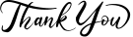


Slide 26


QUESTION TIME!!

